Slide 1
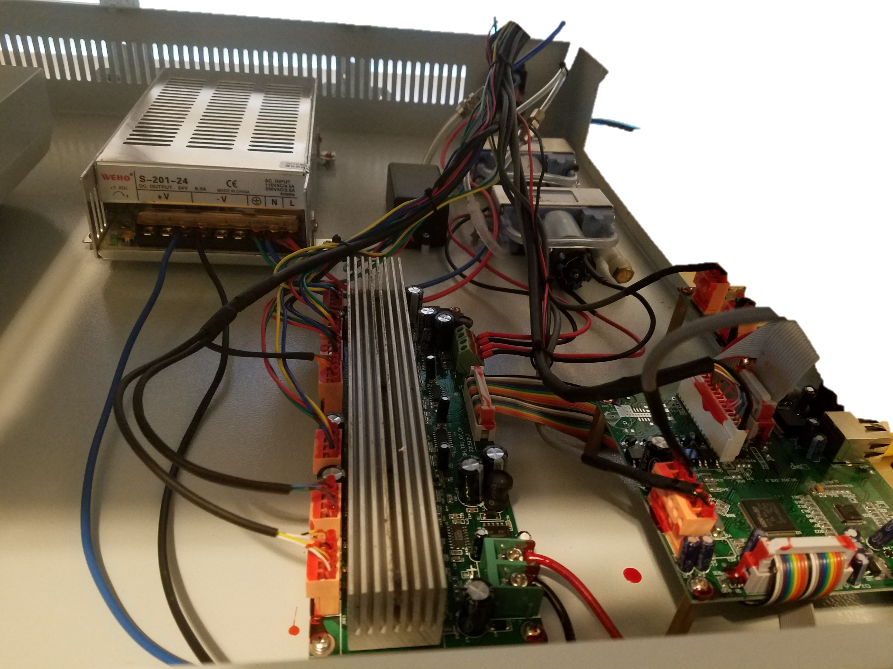

Slide 2
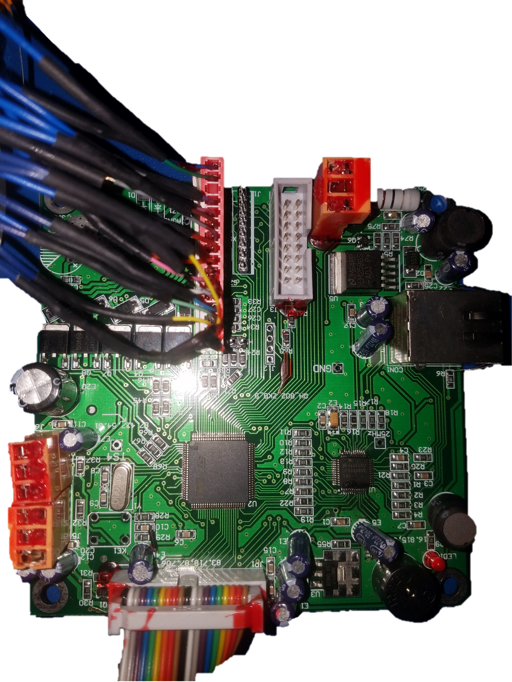
Gnd
12V
Pin Sensor - 3.3V
Pin Solenoid - 24V
nc
5V
Gnd
Vacuum Sensor 1 – 3.3V
Vacuum Sensor 2- 3.3V
Vacuum Solenoid 2 -24V
Blow Solenoid 1 - 24V
Blow Solenoid 2- 24V
Vacuum Solenoid 2-24V
24V
right end stop - 3.3V
Left end stop - 3.3V
Gnd
Gnd
5v
Front Stop
Gnd
5V
Back Stop
gnd

Slide 3
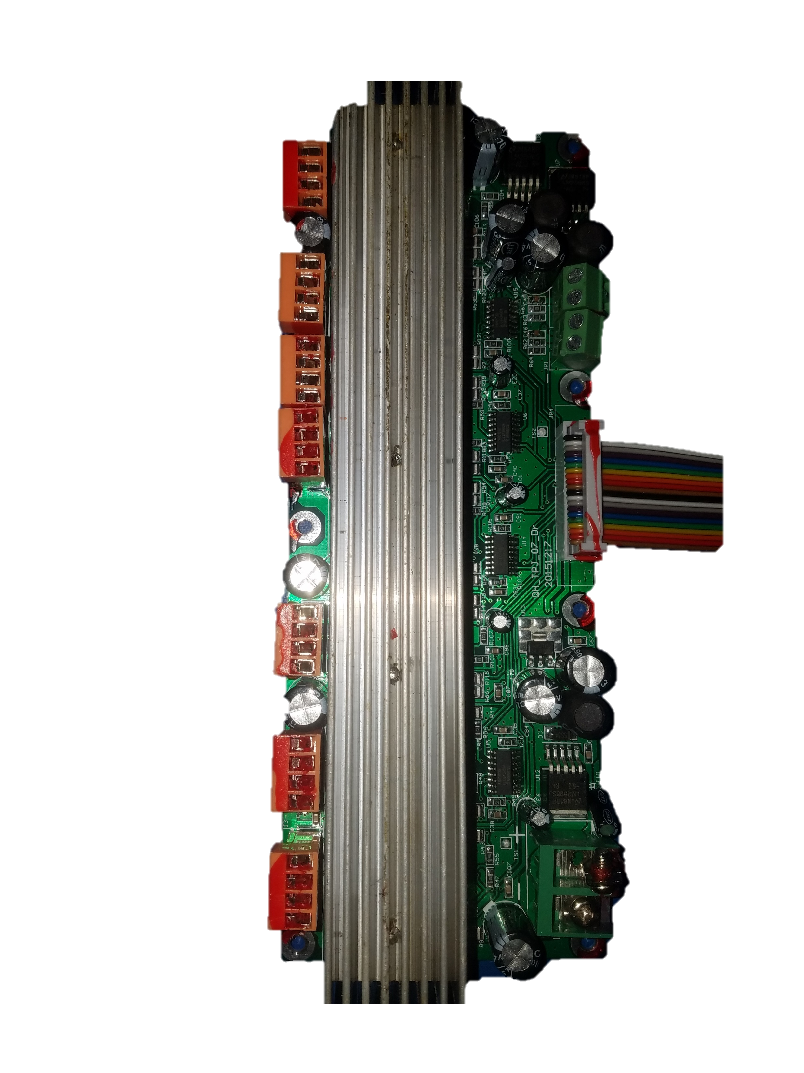
Front Back Stepper
Coil A
Coil A
Coil B
Coil B
Strip Back Stepper
Coil A
Coil A
Coil B
Coil B
Strip Left Stepper
Coil A
Coil A
Coil B
Coil B
Rotate Nozzle 2 Stepper
Coil A
Coil A
Coil B
Coil B
Z Stepper
Coil A
Coil A
Coil B
Coil B
Rotate Nozzle 1 Stepper
Coil A
Coil A
Coil B
Coil B
Left to Right Stepper
Coil A
Coil A
Coil B
Coil B

Slide 4
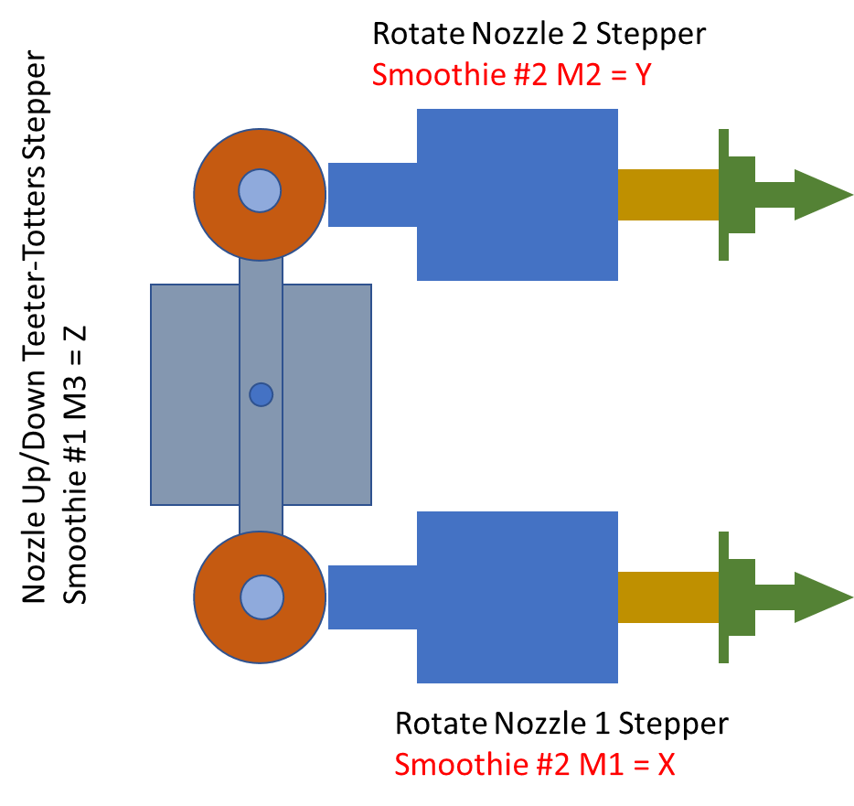




Vacuum Sensor #1
Smoothie #1 vac1read
Pump #1
Smoothie #1 M48=on, M49=off
Solenoid #1
Smoothie #1 M44=on, M45=off
Solenoid Blow 1
Smoothie #2 M52=on, M53 = off
Blower
Always on
Vacuum Sensor #2
Smoothie #1 vac2read
Solenoid Blow 2
Smoothie #2 M54=on, M55 = off
Pump #2
Smoothie #1 M42=on, M43=off
Solenoid #2
Smoothie #1 M47=on, M47=off

Slide 5
Nozzle Up/Down Teeter-Totters Stepper
Smoothie #1 M3 = Z
Rotate Nozzle 2 Stepper
Smoothie #2 M2 = Y
Rotate Nozzle 1 Stepper
Smoothie #2 M1 = X

Slide 6
